Slide 1


Lecture 10:
Pokemon Classifier
Application (Frontend)
McGill Artificial
Intelligence Society

Slide 2
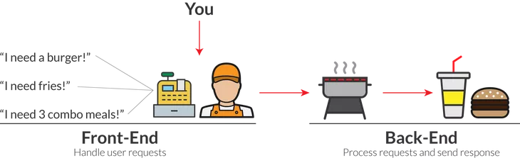
Web Application Structure Recap
Yesterday we built the backend component of our application. The front-end can ask for something, and the back-end can process it.
Today, we will learn how to build the user interface because a regular user does not know how to use APIs.

Slide 3
Frontend Web Development Basis
The frontend of a web application consists of 3 languages that combine together to form a user interface that your browser can display.
1 HTML
Used to code the actual components on the page - titles, headers, navigation bars, paragraphs, etc.
2 CSS
Used to change the way the components are displays - colours, fonts, position on the screen, etc.
3 Javascript
Used to create dynamic interactions - interactions with APIs, scrolling animations, etc.

Slide 4
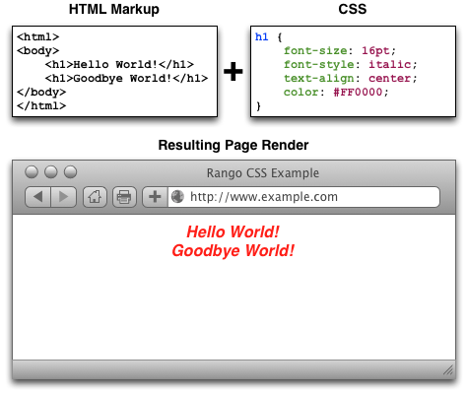
HTML and CSS Example

Slide 5

Frontend Web Development Frameworks
Creating applications with purely HTML/CSS/Javascript can get very messy when the application becomes larger.
Therefore, we use front-end frameworks to make this process easier. Others wrote code to make it easier for us to write code.

Slide 6



Slide 7

Jinja Structure
Jinja was built by the creators of Flask. The Flask server takes templates along with static files and renders them in the browser with the appropriate variables.
Jinja
app.py
.html
Server
Templates
.css .js
Static Files
Browser

Slide 8

https://www.chatroom-server.co/
Back To Our
Chatroom!

Slide 9
Let’s put our pokemon classifier application together!

Slide 10
Let’s Put Our Application Together!
Yesterday, we built a server with the following API structure.
Instead of using postman, we will now build a proper UI using Jinja.
predictor.py
app.py
REQUEST (POST)
url -> “/classify”
body -> .png file
Predictor
Server
RESPONSE
json -> prediction

Slide 11
Let’s Put Our Application Together!
Our final application structure will look like this.
Jinja
predictor.py
app.py
.html
Predictor
Server
Templates
.css .js
Static Files
ML Model
Browser
model.pth

Slide 12
Our application is simple and it works! But better practices can be used...

Slide 13
Things to consider for scalability
Host the model as a stand alone web service
Run hosted model on a GPU/FPGA/ASIC if necessary
Use a more scalable frontend framework such as Angular or React
Expose REST APIs through HTTP communication
Use a database to save the new data that is retrieved.

Slide 14
And We Are Done!
Any questions?
McGill Artificial
Intelligence Society

